Slide 1
Personas
Halton Hills Heritage
Vith Sivaloganathan

Slide 2
James Edwards - Frustrated
James is a hopeful new small business owner in Georgetown, a community within Halton Hills. James quit his regular, nine to five banking job to follow his dreams. He had finally saved up enough money to buy small commercial property in Georgetown’s core, to start a family-owned pizza shop. James, his wife and two daughters are excited and eagerly waiting to get their new shop up and running. But renovations to the shop quickly came to a halt, when the contractors had realized the Edwards’ property is listed as a Heritage Site. The proposed changes to the storefront cannot be made due to some restrictions placed on heritage properties. The shop is now going to take longer than expected to open. James wants to use the Halton Hills website to see what changes are allowed and what he needs to consider before quickly redesigning the store front to prevent further delays.
“I should be able to do whatever I want to my property… this is why I bought not leased”

Slide 3
James – The Hopeful Business Owner
Demographics:
A married 42 year old with two daughters, looking to get away from the hustle and bustle of city life. James moved to Georgetown in 2012, when he and his wife bought their first brand new family home. James was a senior manager at a Major bank in Toronto. He and his wife were making a combined income of over $150,000; when both of them were working. He has now left behind his illustrious banking career to follow his dreams and build something for himself.
Goals:
James needs to get his store open ASAP. James hasn’t heard of designated Heritage Sites before. He needs to find out what it means to be listed as a Heritage Site. He also needs information regarding the types of renovations he is allowed to do to his property.
Tech Profile:
James is quite tech savvy. He enjoys playing with new “gadgets” and “toys” that come out. He has kept up with some of the current internet trends and claims he cannot live with out the internet. He also enjoys using Social Media to keep up with his friends and family. He mainly uses Facebook for family and friends. Twitter to keep up with current news and trends. James loves to spend time watching videos on YouTube. James has not visited the Halton Hills website before.
Needs:
Legal definition of a heritage site, acts and laws surrounding Heritage Sites
Information on the modifications/ renovations that can be done to a heritage site.
Where and how to get permission for changes
Possibility of getting the property of the Heritage Listing

Slide 4
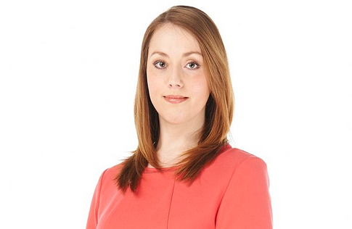
Mary Allen - Excited
Mary just recently got engaged to the love of her life Tom. Both Tom and Mary are excited and looking forward to starting their life together. They have planned their wedding for next year. Currently Tom and Mary live at home with their parents. They want to buy a house before they get married. They have lived their entire lives in Halton Hills and plan on starting their family there as well. As with any young soon to be families, Mary and Tom do not have a lot of much money to purchase their first home. Mary likes the idea of owning a unique, heritage home, rather than the cookie cutter communities springing up in her locale. Mary has heard there are benefits of owning a Heritage Home. Mary wants to use the website to explore her homeownership options. She also wants to research if there are any other benefits, such as government incentives for heritage property owners.
“I love Halton Hills! This is home, and I can’t see my self leaving. A long line of my own heritage is here, it’s a big part of me”

Slide 5
Mary– Young, First Time Homeowner
Demographics:
A 27 year old, soon to be first time homeowner, who has lived herentire life in Halton Hills. Mary works in retail and her fiancée Tom is a consultant. Together they make around $75,000 an year.
Goals:
Mary needs to find out if there are any Heritage Benefits Plans offered to Heritage Homeowners. She also needs to find out where she can find information on Heritage homes for sale.
Tech Profile:
Mary is an avid smartphone and internet user. She uses various social media platforms and apps daily. She even maintains a blog dedicated for her pets. She has visited the Halton Hills website a few times before.
Needs:
Heritage Benefits Plan for homeowners
Pros and Cons of Heritage Home Ownership
For sale section – or realtor recommendations
Searchable and filterable list of Heritage properties

Slide 6
Personas were based on the Census Profile for Georgetown:
https://www12.statcan.gc.ca/census-recensement/2011/dp-pd/prof/details/page.cfm?Lang=E&Geo1=POPC&Code1=0314&Geo2=PR&Code2=01&Data=Count&SearchText=&SearchType=Begins&SearchPR=01&B1=All&Custom=&TABID=1

